Slide 1

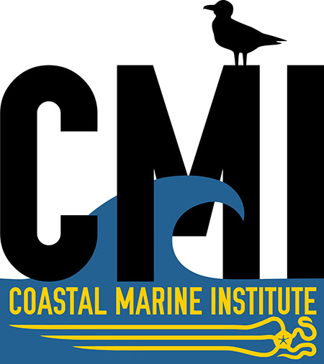

Development of an autonomous carbon glider to monitor sea-air CO₂ fluxes in the Chukchi Sea
Claudine Hauri, Brita Irving, Andrew McDonnell, Peter Winsor, and Hank Statscewich
Project duration:
April 2015 – March 2018
chauri@alaska.edu

Slide 2
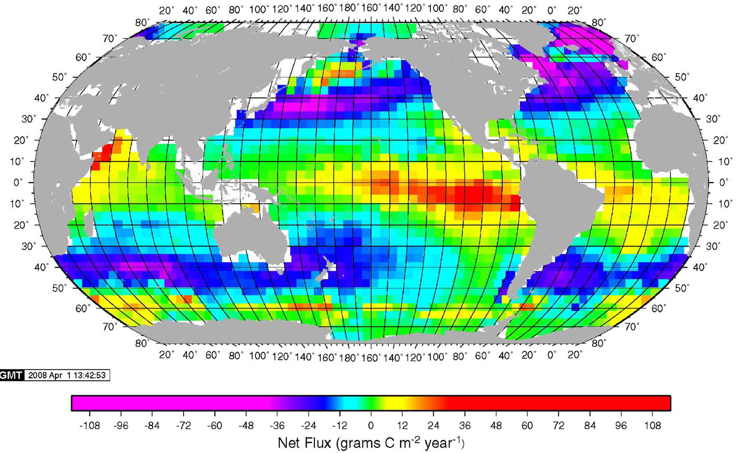
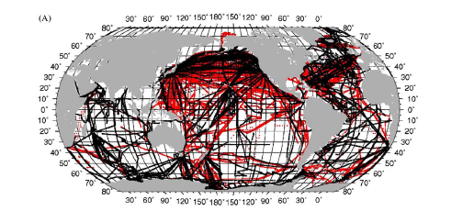
Ship Tracks of Surface Underway pCO₂
Takahashi et al., 2009
Notes:
The partial pressure of CO2 or what I will be referring to as pCO2 is a measure that can be related to the concentration of CO2 in seawater
pCO2 is very important variable because it tells us about the oceans role in the global carbon cycle and it lets us determine the rates of exchange of carbon dioxide between the ocean and atmosphere.
This is why a lot of effort has gone into measurements. Ships all over the world have been outfitted with surface underway pCO2 systems as a low cost way of mapping the global oceans.
But - Unfortunately, these CONTINUOUS AND HIGH RESOLUTION measurements are all limited to surface waters and do not give us any information about how the carbon is distributed and cycled in the water column. At present, the only way to get subsurface distributions of pCO2 is through discrete water sampling.
FOR THIS REASON WE were motivated TO DEVELOP A NEW TOOL THAT WOULD GET US HIGHLY RESOLVED CARBON DIOXIDE DATA THROUGHOUT THE WATER COLUMN.

Slide 3
Importance of Subsurface
pCO₂ Measurements
Hauri et al., 2013
Notes:
One of the regions that we are especially interested in is the Chukchi Sea.
The Chukchi Sea is a highly dynamic system in terms of the carbon cycle.
Various studies have also proposed that the Chukchi Sea is the predominant contributor to CO2 uptake in the Arctic Ocean.
However, our recent study of surface pCO2 in the Chukchi Sea indicated that the break down of stratification due to storm events, especially in fall months, can lead to mixing of high CO2 water to the surface, thereby leading to outgassing of CO2 into the atmosphere. This process would reduce export and sequestration of CO2 into the Arctic Basin.
Unfortunately, a full understanding of the processes at work is limited, because we did not have detailed measurements of the subsurface distribution of carbon dioxide before, during and after these storm cycles.
So our question was, how can we sample this system better?
Ship based collection of discrete water samples is expensive and difficult during the season when these storms are really strong.
Underway surface CO2 measurements does not give us the full picture
Mooring based sensors would be an improvement, but they don’t offer any spatial coverage, which is important, especially in an advective and variable system like the Chukchi Sea.

Slide 4
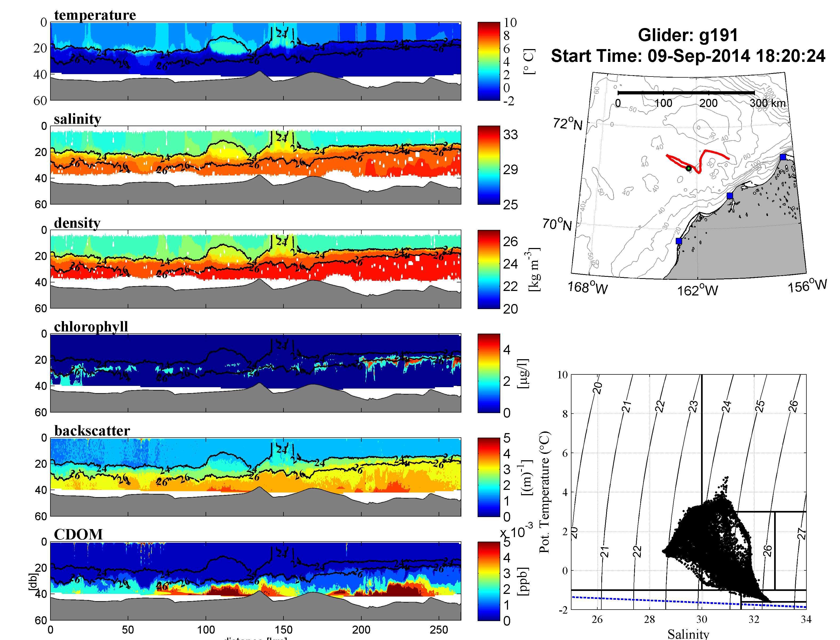
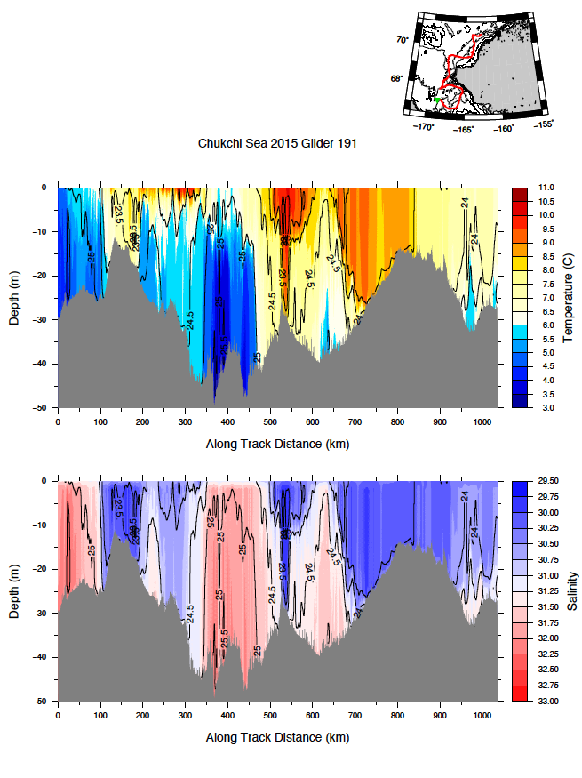
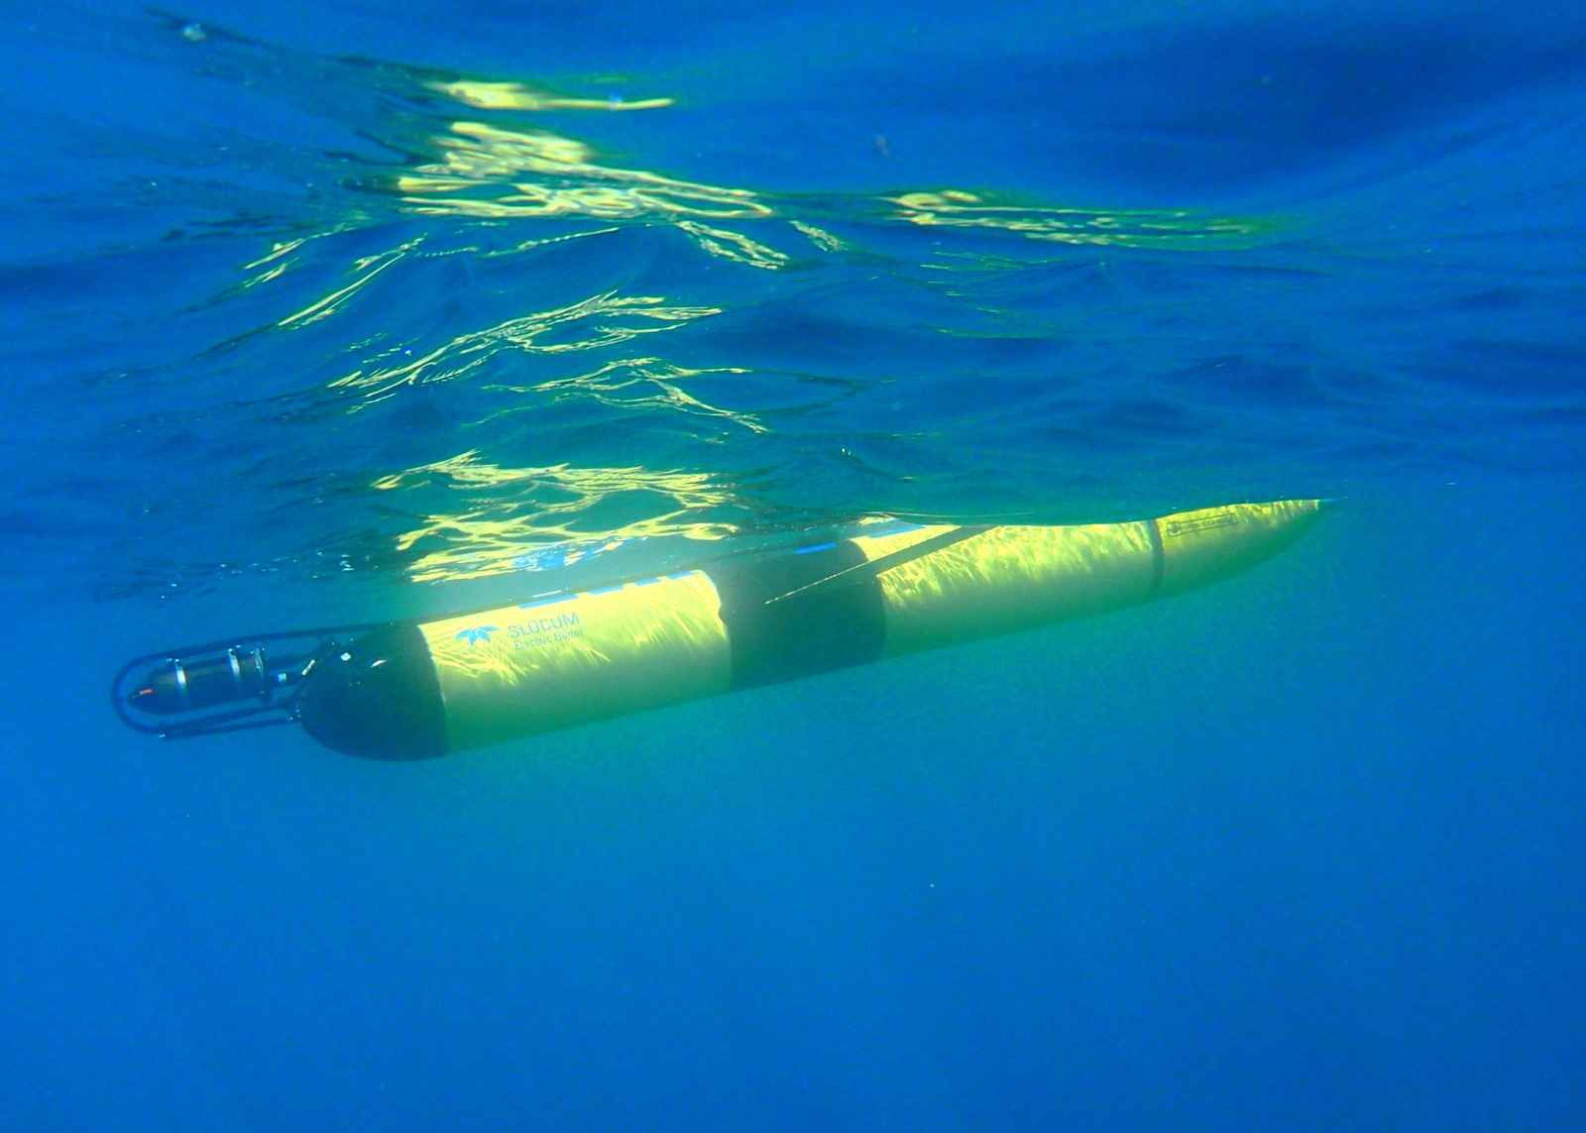
TWR Slocum Autonomous Underwater Glider
Notes:
A profiling glider is an autonomous platform that can provide us with exactly what we are looking for. So far, they have been used to collect these beautiful rich data sets of temperature and salinity that reveal important features such as stratification, mixing, and fronts.
So the obvious question arose: “Can we use gliders as a platform for high resolution mapping for both surface and subsurface carbon dioxide?

Slide 5
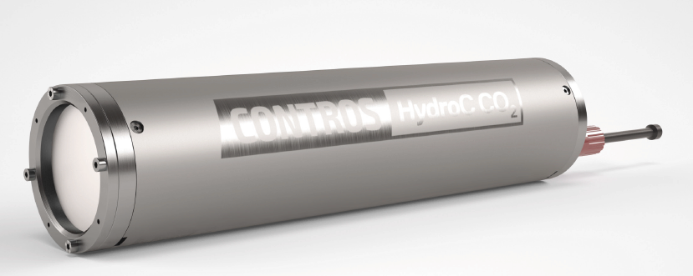
pCO₂ Sensor Requirements
Fast response time
Lightweight
Compact
Low power
Rapid Data Output
Notes:
Over the last five years there has been an explosion in the number and capabilities of pCO2 sensors.
These are based on a variety of technologies. The industry standard is a membrane based sensor that allows carbon dioxide to diffuse through a membrane to the gas detector on the inside of the housing.
However the response time of these sensors is too slow to resolve the rapid changes in pCO2 that are expected as the glider profiles through the water column. Furthermore, the sensor also has to be compact and relatively low power.
In order to obtain a sensor that met our demands we partnered with the sensor manufacturer Pro-Oceanus to develop a modified version of their existing membrane-based Mini Pro CO2 sensor.

Slide 6
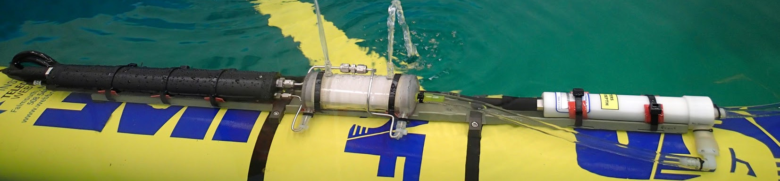
First Prototype:
Hollow Fiber Membrane
Benefit:
Larger surface area -> faster response time
Issue:
Clogging after about a week -> variable response time
Notes:
Here is what we came up with:
We replaced the conventional flat membrane of the pCO2 sensor with a hollow fiber module.
The hollow fiber module is essentially a spindle of hundreds of small diameter silicon tubes.
The benefit of doing this is that we can scale up from a membrane that originally had a surface area of a few centimeters to a component that has one square meter of surface area all contained in a small compatible form factor.
Lab testing of the carbon glider with the first pCO2 sensor showed however, that the fine hollow fiber module clogs after about a week, resulting in variable response times. However, the data that came from the intensive testing gave us enough confidence that the variable response time could be corrected adequately. We therefore proceeded with the first ever carbon glider field trials in Seward.

Slide 7
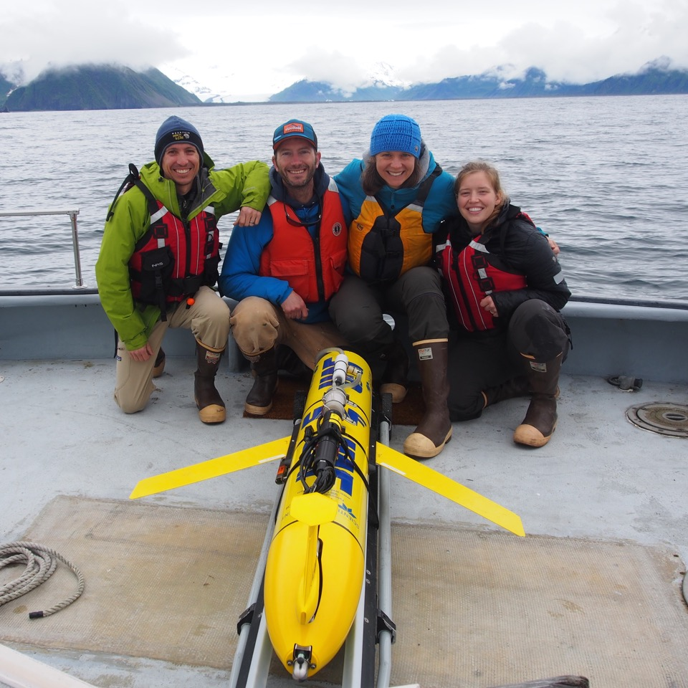

Slide 8
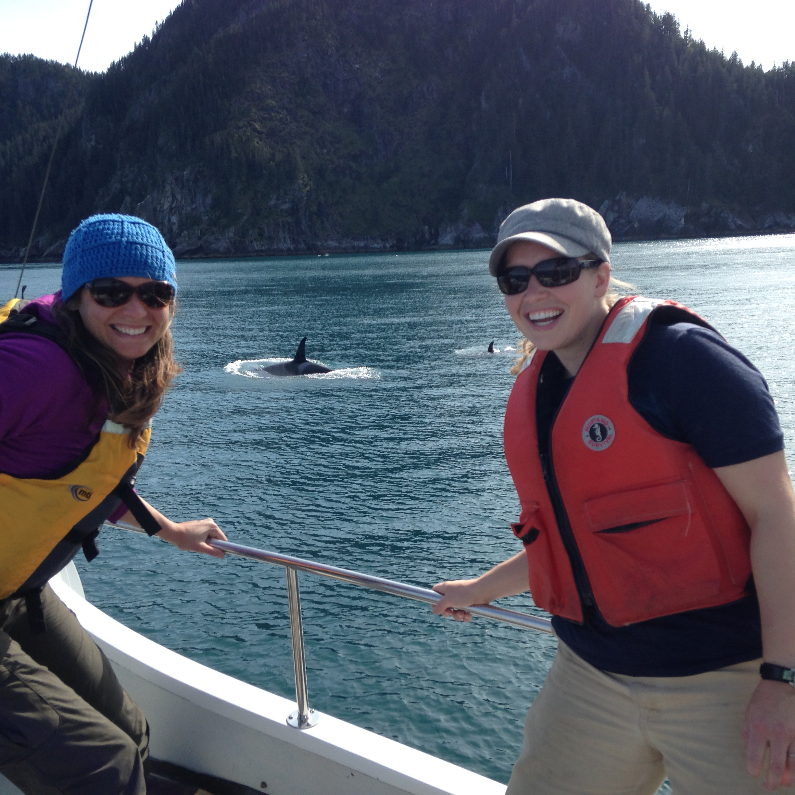

Slide 9
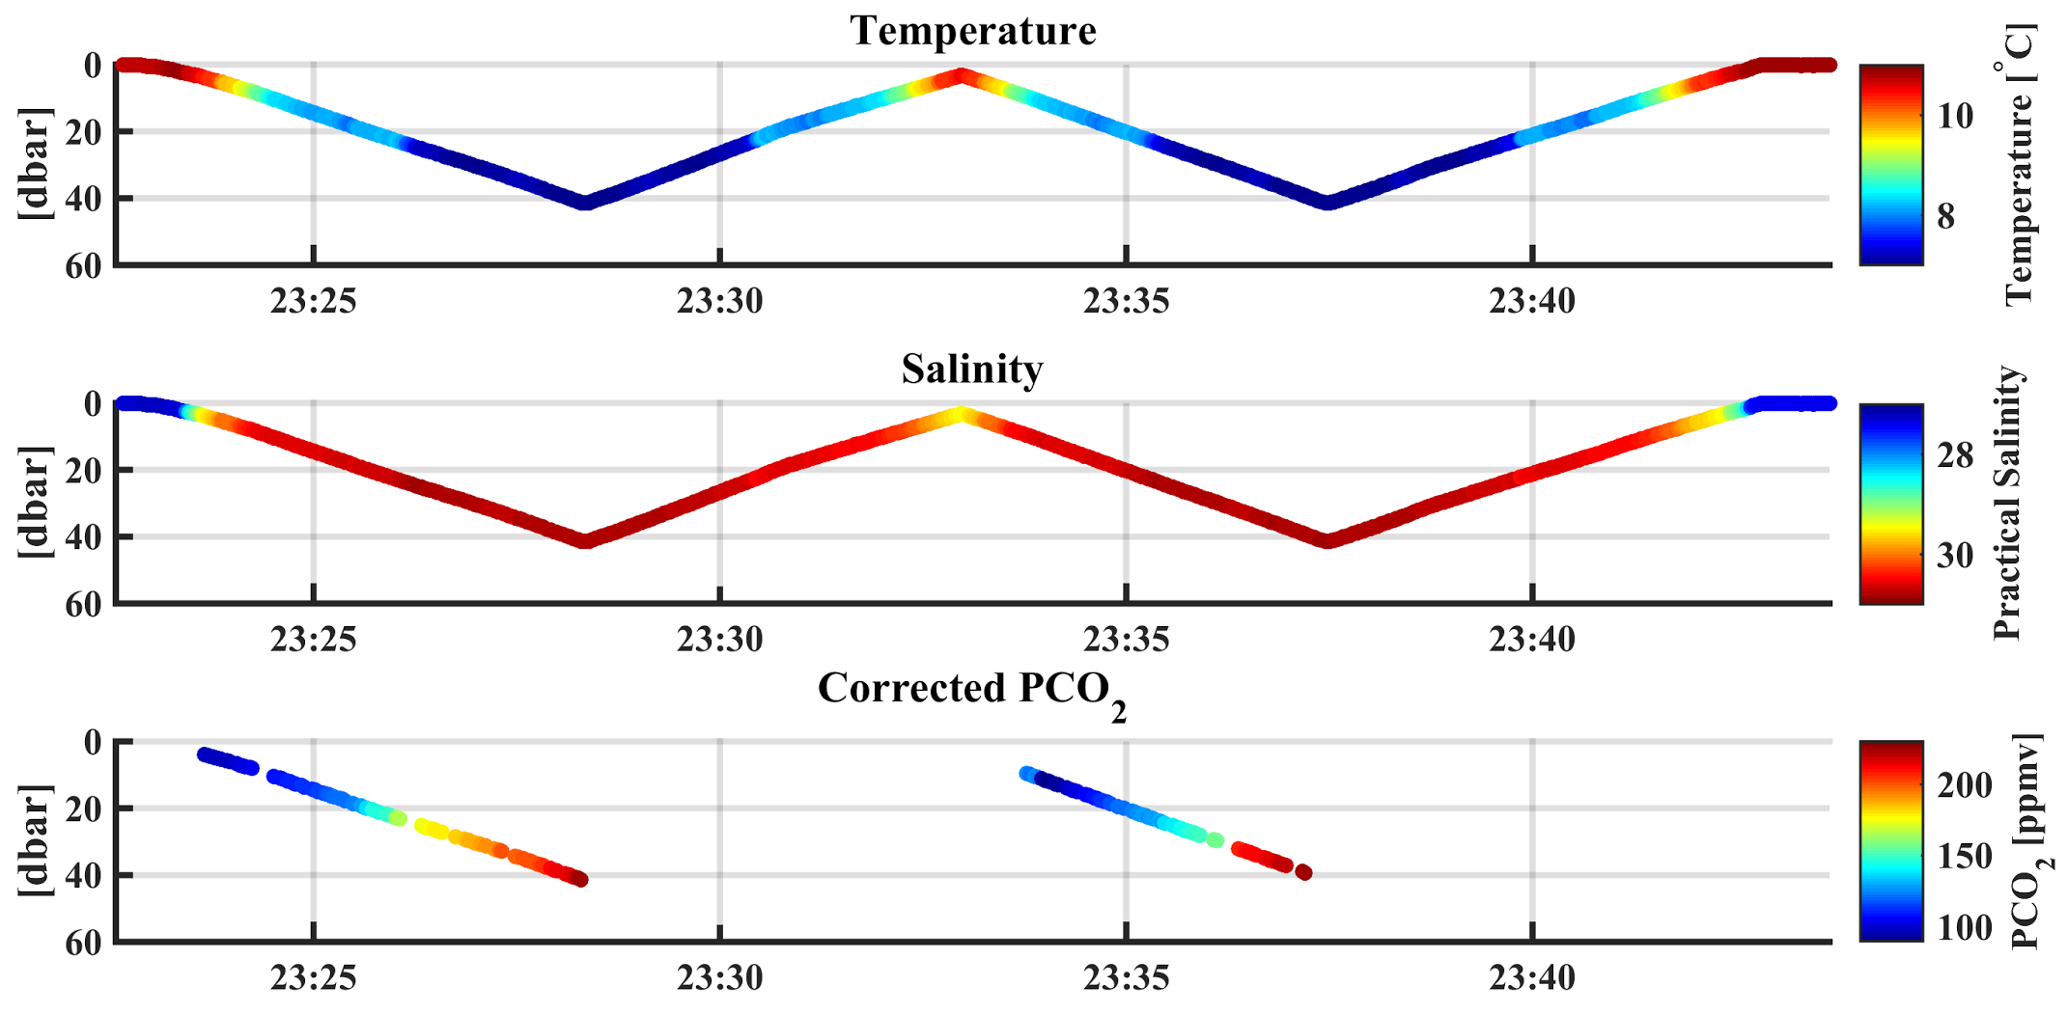
Success!
First autonomous pCO2 profile
But…
Hollow fiber module failed on second mission
Notes:
First ever field-testing of the ACG showed that the integration of the Teledyne Webb Slocum Glider, the Pro-Oceanus Mini-Pro pCO₂ sensor (Prototype 1) and a Seabird 5P submersible pump was successful (Figure 1, upper panel). The ACG operated as expected during the course of several dive and climb cycles to successfully communicate with each other to record pressure, temperature, salinity, backscatter, Chlorophyll-a, CDOM concentrations, and the partial pressure of carbon dioxide (pCO₂) data throughout the water column (Figure 2). We were able to verify that the addition of the pCO₂ sensor and pump, which directed seawater through the hollow fiber module, did not significantly alter the flight characteristics of the glider.
Data suggest that the hollow fiber module failed on the second mission at pressures within our intended working depths. Combined with the findings from our lab testing that indicated the hollow fiber module is susceptible to clogging and requires a high-powered pump (both of which shorten mission duration), we determined that the hollow fiber module is not suitable or ideal for the intended glider application.

Slide 10
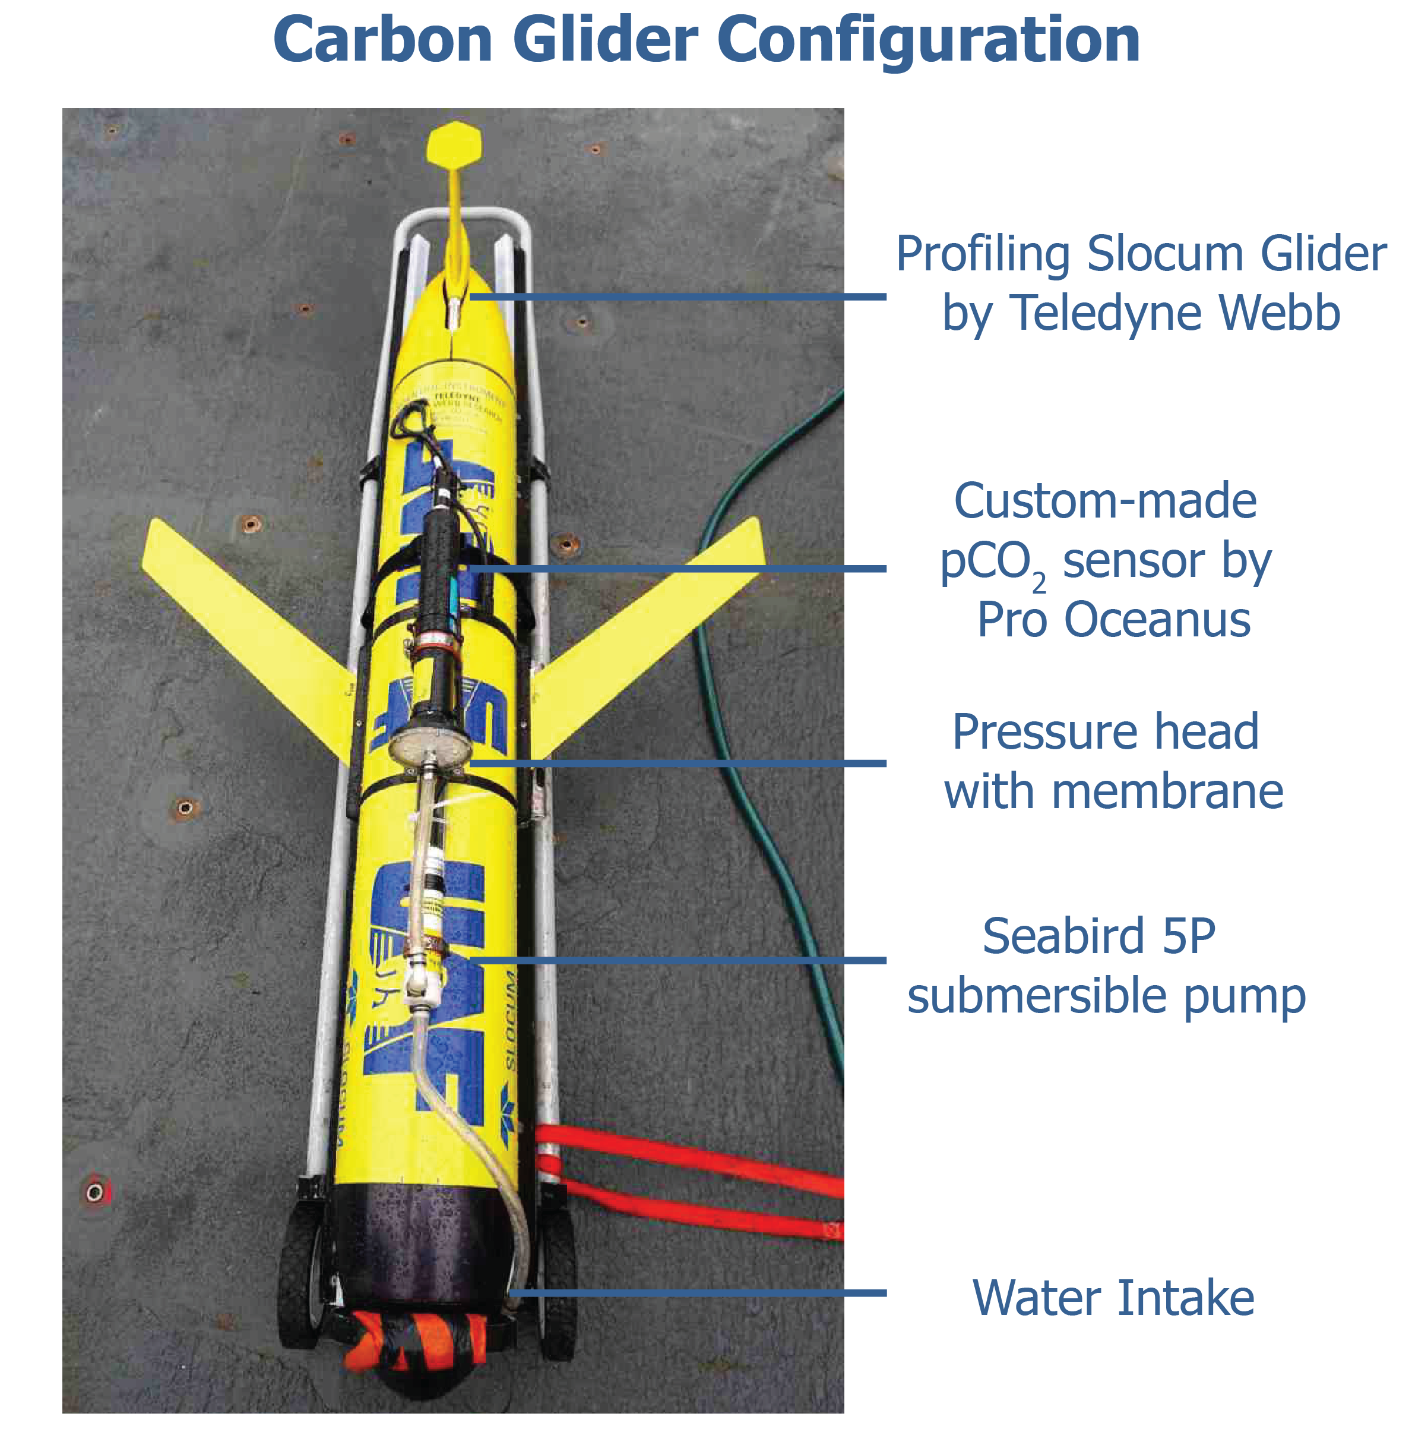
Second Prototype
Notes:
In close collaboration with the pCO₂ sensor manufacturer Pro-Oceanus, we modified our sensor configuration to work without the hollow fiber module. Prototype 2 features a modified pressure housing designed to accommodate the large (4”) diameter disc membrane head commonly used in their workhorse CO₂ sensor, the Pro-CV. The combination of the Pro-CV membrane with the small electronic board of the Mini Pro CO2 sensor keeps the sensor compact, which is necesaary for out glider application. With the conventional flat membrane, this new sensor configuration allows us to fly longer missions since it is much less power hungry and susceptible to clogging.

Slide 11
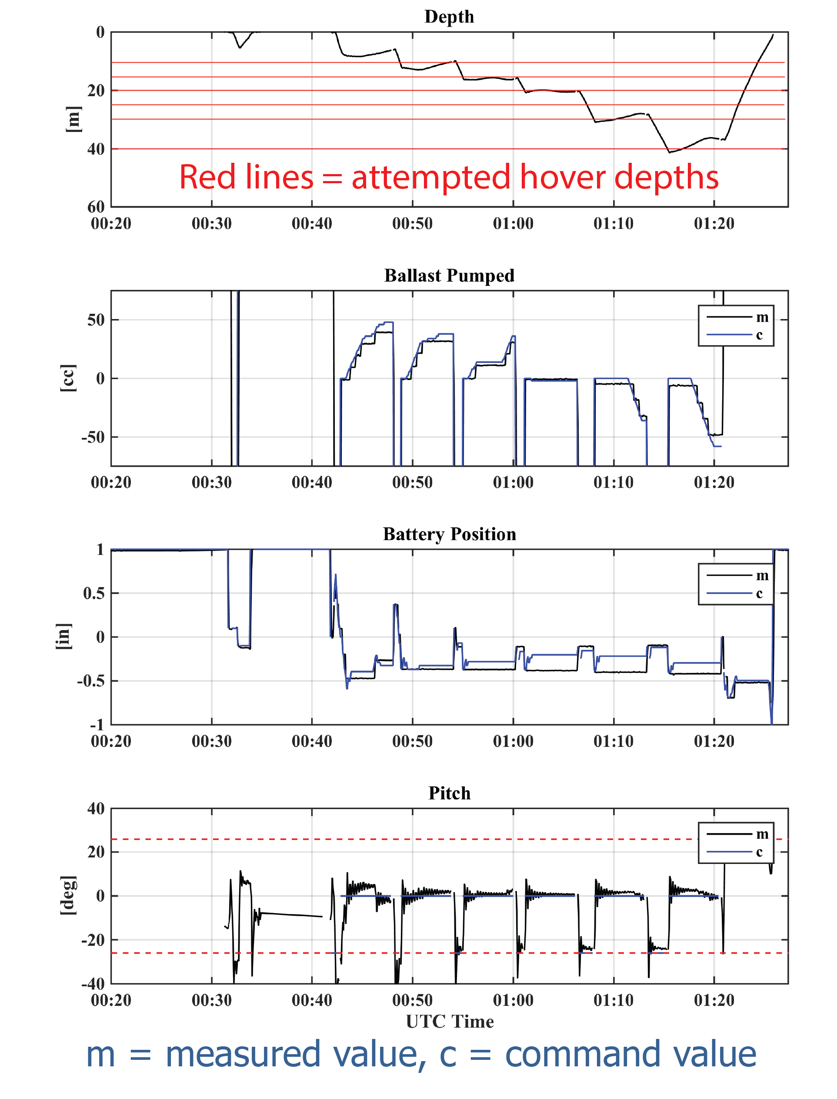
Hover Missions
Notes:
Because the response time of prototype 2 is slower than prototype 1, we decided to adjust the flight mode of the glider. We were able to construct glider flight control missions, which hover the vehicle at various prescribed depths for a preset time. A hover mission isnot a common glider mission profile and are not readily available. It took several attempts to refine the technique and we are still working on details to successfully hover the glider, even in large density gradients, as often observed in the Gulf of Alaska in summer. The hovering behavior of the glider is a powerful new tool when it is applied to sensors that require an equilibration period such as our ne pCO2 sensor prototype. The hover missions will enable periodic stops at discrete depths for accurate measurements of pCO₂, even with sensors that have extended response times.

Slide 12
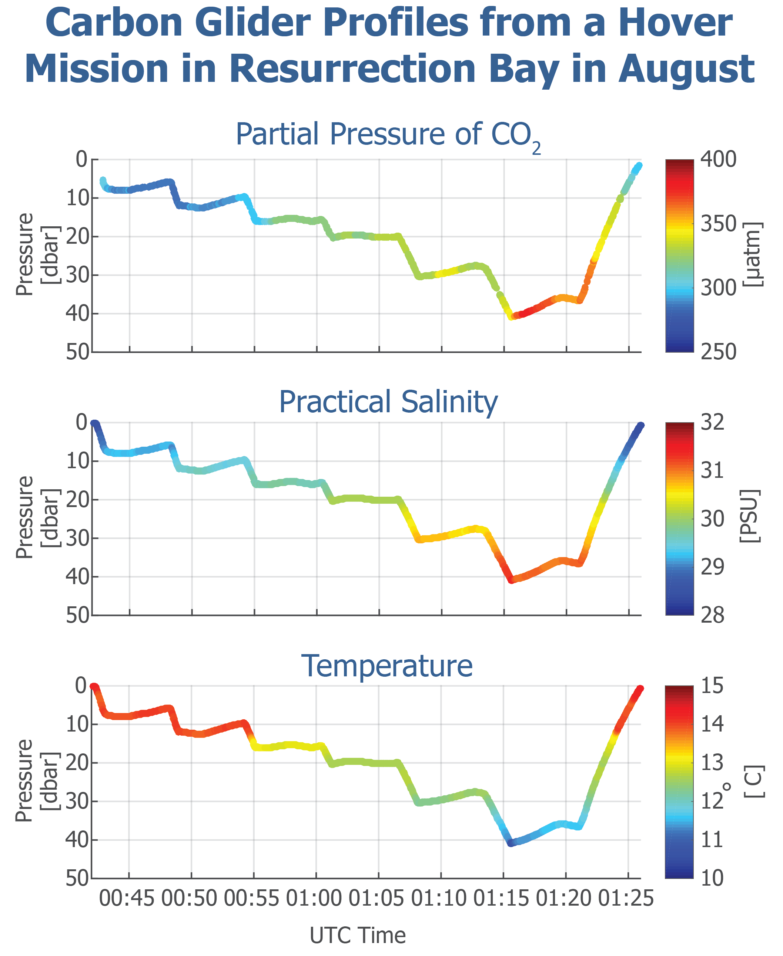
Notes:
Conditions in Resurrection Bay were not favorable for glider missions. Unexpectedly low surface salinities of 18 salinity units led to a density gradient twice as large as the glider could handle in the upper 40 m of the water column at our regular field test sites. We therefore spent the first six hours of the day steaming on board the small vessel Dora in search of a suitable deployment environment. We finally were able to deploy the glider in the Gulf of Alaska, about 25 nm offshore from Seward, where we encountered surface salinities of 26 and a manageable density gradient of 6 sigma units.
We then conducted a hover mission with programmed hover depths every 5 m between 5 and 40 m (Figure 4). The glider executed this hovering by dynamically adjusting the battery position such that the glider maintained a level pitch. Meanwhile, the buoyancy was also adjusted dynamically to bring the glider to the desired depth. At the 15 and 20 m hover depths, the glider was essentially neutrally buoyant and required very little buoyancy adjustments. At other depths, significant buoyancy adjustments were required to reach the desired depths. These difficult conditions pointed out the need to continue improving the glider’s hovering capabilities by refining the flight control in response to the local conditions. During the hover missions, pCO₂ stabilized within a few ppm, demonstrating that short hover missions can achieve equilibration of the sensor, and the construction of pCO₂ profiles in the water column

Slide 13
Completed Milestones
Integration of Pro-Oceanus Mini-Pro with the Teledyne Webb Slocum Glider
Collection of first ever glider-based profiles of pCO₂
Development of glider hover missions
Additional modifications and improvements to the pCO₂ sensor
Notes:
Thus far we have reached several major milestones in this project: 1) integration of the physical, power, communication, and software systems of the Pro-Oceanus Mini-Pro with the Teledyne Webb Slocum Glider, 2) collection of the first ever glider-based profiles of pCO₂, 3) development of glider hover missions that allow for full sensor equilibration and the use of sensors with slower response times, and 4) additional modifications and improvements to the pCO₂ sensor, which make it less vulnerable to clogging and flooding.

Slide 14
Future Milestones
Additional improvements of sensor
    Membrane stability despite large/quick temperature and pressure changes
Final Seward Sea Trials
    Further refinement of hover missions
    adjust the hovering controls and duration to the equilibration time of the sensor
    Proof of concept during multi-day long glider mission
Notes:
Future milestones include additional improvements of the sensor to increase membrane stability despite large/quick temperature and pressure changes.
In May we will conduct a last set of carbon glider sea trials in Seward.
During the final Seward sea trials that are planed for spring, we will further test the pCO₂ sensor, improve the glider hovering capabilities, and adjust the hovering controls and duration to the equilibration time of the sensor. The overall goal of the final Seward Sea trials is to fly the carbon glider for a few consecutive days, ground-truth the pCO₂, salinity and temperature data with CTD casts, and proof the overall concept of our newly developed carbon glider.

Slide 15
Many thanks to
Notes:
The entire carbon glider team has really enjoyed working on the development of the carbon glider and we would like to thank BO

